Slide 1
Ai Vision

Slide 2
To install pip
Update pip
Installing jupyter Notebook
python get-pip.py
python -m pip install --upgrade pip
python -m pip install jupyter
python -m notebook

Slide 3
To install python 3.11
Microsoft store or pyweb

Slide 4
Computer Vision Library
To install pip install opencv-python
Access image
Cv2.imread
Cv2.imshow
Gray Scale image ?

Slide 5
Loading an Image:
image = cv2.imread('b.jpg')

Slide 6
Error Handling for Image Loading:
if image is None:
print("Error: Could not load image. Please check the file path.")
exit()

Slide 7
Convert into Gray scale
import cv2
image = cv2.imread('a.jpg',0)
cv2.imshow('window_name', image)
cv2.waitKey(0)
cv2.destroyAllWindows()

Slide 8
Converting Image to Grayscale:
gray_image = cv2.cvtColor(image, cv2.COLOR_BGR2GRAY)

Slide 9
Resize an image
import cv2
img = cv2.imread('a.jpg')
desired_size = (200, 400)
resized_img = cv2.resize(img, desired_size)
cv2.imshow('Resized Image', resized_img)
cv2.waitKey(0)
cv2.destroyAllWindows()

Slide 10
Draw the Line:
cv2.line(image, (50, 50), (400, 400), (0, 255, 0), 5):
Draws a line on the image.
(50, 50): Starting point of the line.
(400, 400): Ending point of the line.
(0, 255, 0): Green color in BGR format.
5: Thickness of the line.

Slide 11
Draw Line
import cv2
# Load an image
image = cv2.imread('a.jpg')
# Draw a line on the image
cv2.line(image, (50, 50), (400, 400), (0, 255, 0), 5)
# Display the image
cv2.imshow('Line', image)
cv2.waitKey(0)
cv2.destroyAllWindows()

Slide 12
Draw the Circle:
cv2.circle(image, (250, 250), 100, (0, 255, 0), 2):
Draws a circle on image.
(250, 250): Coordinates for the center of the circle.
100: Radius of the circle.
(0, 255, 0): Green color in BGR format.
2: Thickness of the circle’s outline

Slide 13
Draw Circle
import cv2
# Create a blank image
image = cv2.imread('a.jpg')
# Draw a circle on the image
cv2.circle(image, (250, 250), 100, (0, 255, 0), 2)
# Display the image
cv2.imshow('Circle', image)
cv2.waitKey(0)
cv2.destroyAllWindows()

Slide 14
Draw Rectangle
Rectangle Parameters:
start_point: The top-left corner of the rectangle.
end_point: The bottom-right corner of the rectangle.
color: The color of the rectangle’s border.
thickness: The thickness of the rectangle’s border.
If you want a filled rectangle, you can set this to -1.

Slide 15
cv2.rectangle()
image:
The image on which you want to draw the rectangle.
(x, y):
This tuple represents the coordinates of the top-left corner of the rectangle.
(x+w, y+h):
This tuple represents the coordinates of the bottom-right corner of the rectangle.
(0, 255, 0): This tuple represents the color of the rectangle in BGR format. Here, (0, 255, 0) corresponds to green color.
2:
This integer represents the thickness of the rectangle's border. Here, 2 means the border will be 2 pixels thick

Slide 16
Draw Rectangle
import cv2
import numpy as np
image = cv2.imread('a.jpg')
start_point = (500, 500) # (x, y) coordinates for the top-left corner
end_point = (2000, 1500)
color = (255, 0, 0)
thickness = 8
# Draw the rectangle on the image
image_with_rectangle = cv2.rectangle(image, start_point, end_point, color, thickness)
cv2.imshow('Image with Rectangle', image_with_rectangle)
cv2.waitKey(0)
cv2.destroyAllWindows()

Slide 17
Lab Task :Rotate an Image ?

Slide 18
Create PNG file of image
import numpy as np
import cv2
image=cv2.imread('a.jpg')
image=cv2.imwrite('ab.png',image)
cv2.imshow('output',image)
cv2.waitKey(0)
cv2.destroyAllWindows()

Slide 19
Guassian Blur filter
Import Libraries:
Load an Image
Define the Kernel Size
Apply Gaussian Blur
blurred_image = cv2.GaussianBlur(image, kernel_size, 0)

Slide 20
Guassian Blur
import cv2
import numpy as np
image = cv2.imread('a.jpg')
# Define the kernel size (must be positive and odd)
kernel_size = (21, 21)
# Apply Gaussian blur
blurred_image = cv2.GaussianBlur(image, kernel_size, 0)
cv2.imshow('Image', image)
cv2.imshow('Blurred Image', blurred_image)
cv2.waitKey(0)
cv2.destroyAllWindows()

Slide 21
Median blur
import cv2
import numpy as np
image = cv2.imread('b.jpg')
kernel_size = 9
# Apply median blur
blurred_image = cv2.medianBlur(image, kernel_size)
cv2.imshow('Blurred Image', blurred_image)
cv2.imshow('Image', image)
cv2.waitKey(0)
cv2.destroyAllWindows()

Slide 22
cv2.THRESH_BINARY
cv2.THRESH_BINARY applies binary thresholding: pixels above the threshold are set to the maximum value, and those below are set to 0.

Slide 23
Image thresholding
import cv2
import numpy as np
image = cv2.imread('a.jpg',0)
threshold_value = 117
max_value = 255
_, binary_image = cv2.threshold(image, threshold_value, max_value, cv2.THRESH_BINARY)
cv2.imshow('Binary Image', binary_image)
cv2.waitKey(0)
cv2.destroyAllWindows()

Slide 24
Canny Edge Detection
Convert the Image to Grayscale:
Set Threshold Values:
Apply Canny Edge Detection:
Display the Original and Edge-Detected Images:

Slide 25
Canny edge detection using intensity gradien
import cv2
import numpy as np
image = cv2.imread('a.jpg')
if image is None:
print("Error: Image not found or cannot be loaded.")
else:
gray_image = cv2.cvtColor(image, cv2.COLOR_BGR2GRAY)
lower_threshold = 50
upper_threshold = 150
, edges = cv2.Canny(gray_image, lower_threshold, upper_threshold)
cv2.imshow('Original Image', image)
cv2.imshow('Edge Image', edges)
cv2.waitKey(0)
cv2.destroyAllWindows()

Slide 26
Shift image
Import Libraries:
Load the Image
Define the Shift Value
Create the Translation Matrix
Apply the Translation

Slide 27
[1, 0, shift_x]:
1: The x-axis scaling factor (no scaling).
0: The x-axis rotation factor (no rotation).
shift_x: The amount by which to shift the image horizontally.
[0, 1, 0]:
0: The y-axis scaling factor (no scaling).
1: The y-axis rotation factor (no rotation).
0: The amount by which to shift the image vertically (no shift).

Slide 28
Shift image
import cv2
import numpy as np
image = cv2.imread('a.jpg')
shift_x = 100
Create the translation matrix
translation_matrix = np.float32([[1, 0, shift_x], [0, 1, 0]])
Apply the translation to the image
shifted_image = cv2.warpAffine(image, translation_matrix, (image.shape[1], image.shape[0]))
cv2.imshow('Shifted Image', shifted_image)
cv2.waitKey(0)
cv2.destroyAllWindows()

Slide 29
Text on image
Import libraries
Load image
Define parameters
Display image with text

Slide 30
Text on image
import cv2
import numpy as np
image = cv2.imread('a.jpg')
text = 'Hello, Comsats!'
position = (50, 100)
font = cv2.FONT_HERSHEY_SIMPLEX
font_scale = 5
color = (255, 255, 255)
thickness = 2
image_with_text = cv2.putText(image, text, position, font, font_scale, color, thickness)
cv2.imshow('Image with Text', image_with_text)
cv2.waitKey(0)
cv2.destroyAllWindows()

Slide 31
To perform facial detection in an image using OpenCV with a Haar Cascade classifier, you'll follow these steps:
Load the image.
Load the pre-trained Haar Cascade classifier for face detection.
Detect faces in the image using the classifier.
Draw rectangles around the detected faces.
Display the image with the detected faces.
Here's a small Python code snippet that demonstrates these steps:

Slide 32
Loading Haar Cascade Classifier:
cv2.CascadeClassifier()
loads a pre-trained Haar Cascade classifier from a specified XML file. This classifier is specifically trained for detecting frontal faces.
cv2.data.haarcascades
is a variable provided by OpenCV that points to the directory where pre-trained Haar Cascade files are located.
'haarcascade_frontalface_default.xml'
is the XML file containing the trained data for detecting frontal faces.

Slide 33
Face Detection:
faces = face_cascade.detectMultiScale(gray_image, scaleFactor=1.1, minNeighbors=5, minSize=(30, 30))
scaleFactor:
Parameter specifying how much the image size is reduced at each image scale. It compensates for faces appearing smaller due to distance
minNeighbors:
Parameter specifying how many neighbors each candidate rectangle should have to retain it. Higher values help reduce false detections.
minSize:
Minimum possible object size. Objects smaller than this size are ignored

Slide 34
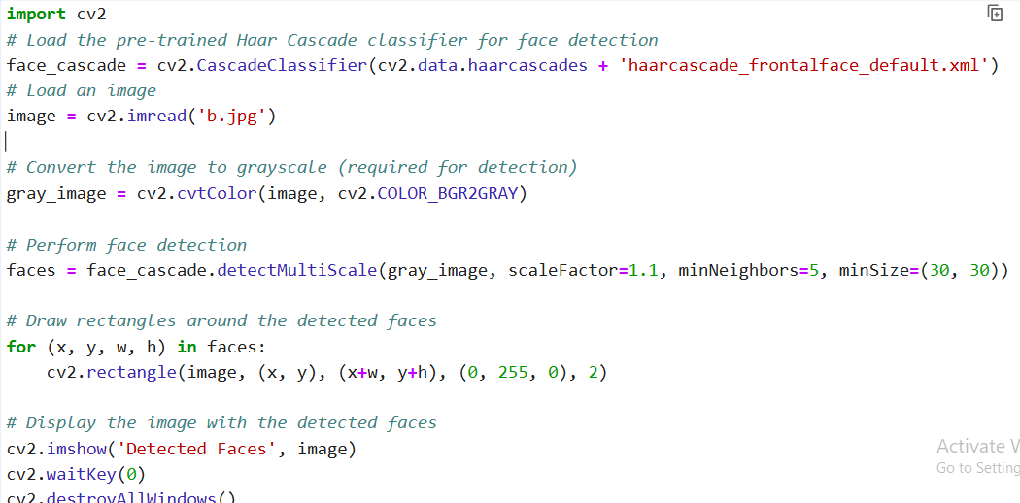

Slide 35
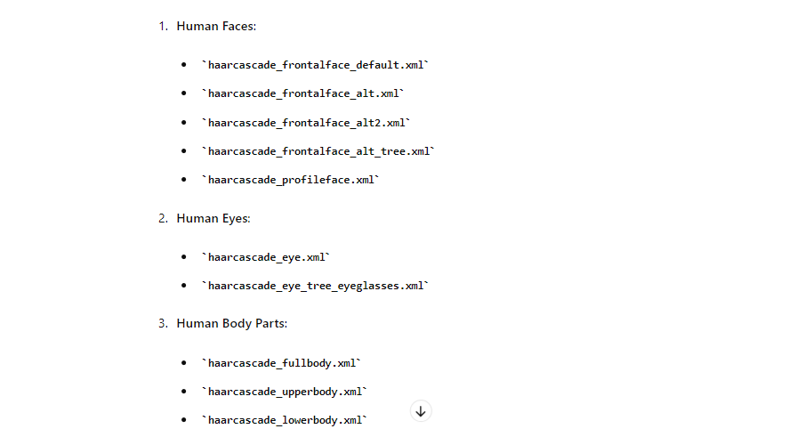

Slide 36
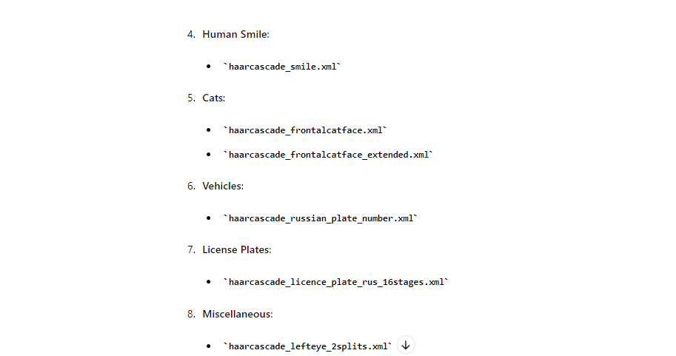

Slide 37
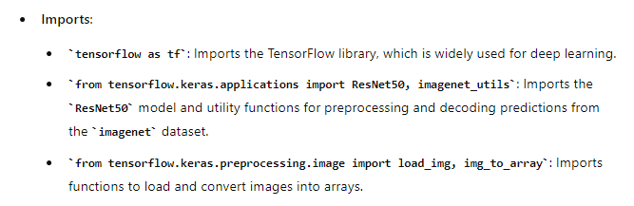
Classification of image using CNN

Slide 38
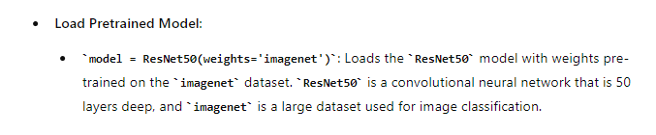
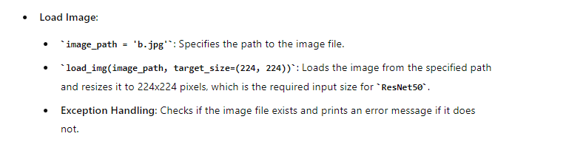

Slide 39
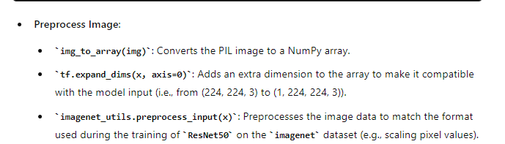
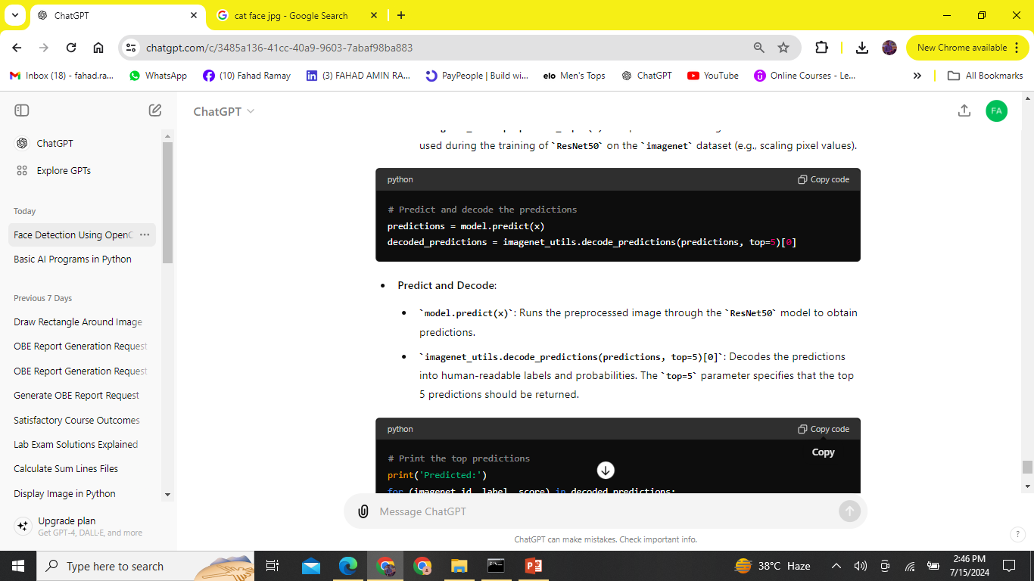

Slide 40
